Slide 1
Mini-Project: End-to-End ELT in Azure
Derek Funk
Springboard Data Engineering Track

Slide 2
Contents
Background
Azure Data Factory - Pipelines
Step 1: Environment Prep
Step 2: Linked_Services_Datasets_and_Integration_Runtimes
Step 3: Copy_Activity_Parameters_Debug_and_Publishing
Step 4: Lookup_activity_ForEach_loop_and_Execute_Pipeline_activity
Step 5: Get_Metadata_activity_filter_activity_and_complex_expressions
Step 6: Self-hosted_Integration_Runtime__decompress_files_and_Delete_activity
Azure Data Factory - Data Flows
Step 7: SmartFoodsCustomerELT
Step 8: ELT_with_Mapping_Dataflows–Practice_excercises

Slide 3
Background
This project is a lab to create an end-to-end ELT using the various components of Azure
all stages of the lab can be found on GitHub: https://github.com/Mmodarre/AzureDataFactoryHOL
this Powerpoint demonstrates how I followed this lab step by step, including images to show specific configurations

Slide 4
Step 1: Environment Prep
https://github.com/Mmodarre/AzureDataFactoryHOL/tree/master/Lab-guide/01-Before_the_hands-on_lab_(Prepare_the_environment)
Back to Table of Contents

Slide 5
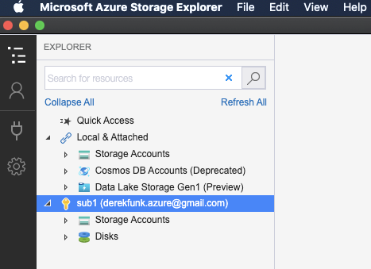
Step 1 - Task 1: Install Azure Storage Explorer
Notes:
installed Az Storage Explorer
connected it to my Az account derekfunk.azure@gmail.com

Slide 6
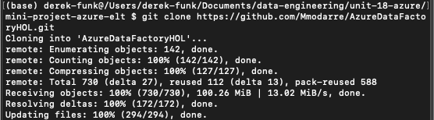
Step 1 - Task 2: Clone the GitHub Repository

Slide 7
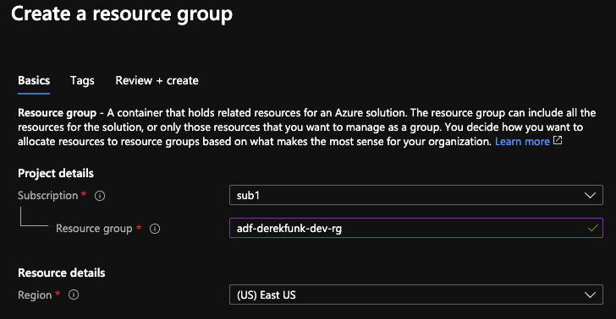
Step 1 - Task 3: Deploy Azure Resource Group
Notes:
created new rg adf-derekfunk-dev-rg

Slide 8
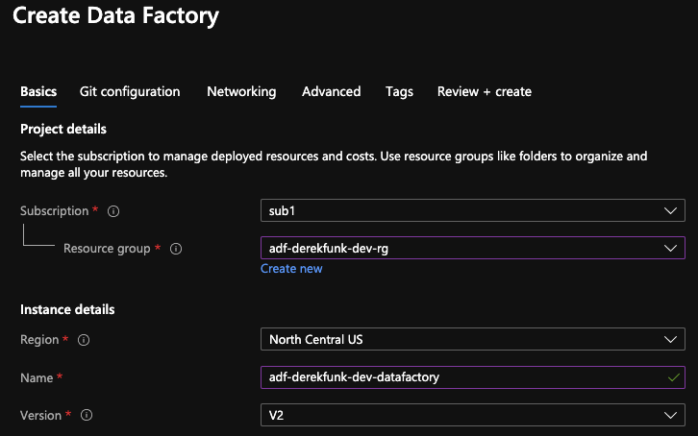
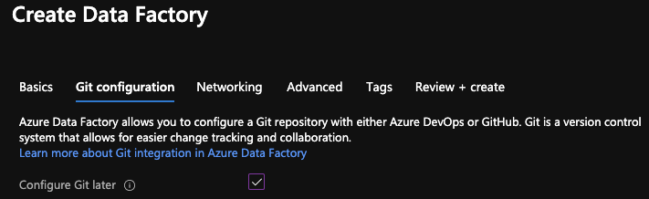
Step 1 - Task 4: Deploy Azure Data Factory
Notes:
created new df adf-derekfunk-dev-datafactory

Slide 9
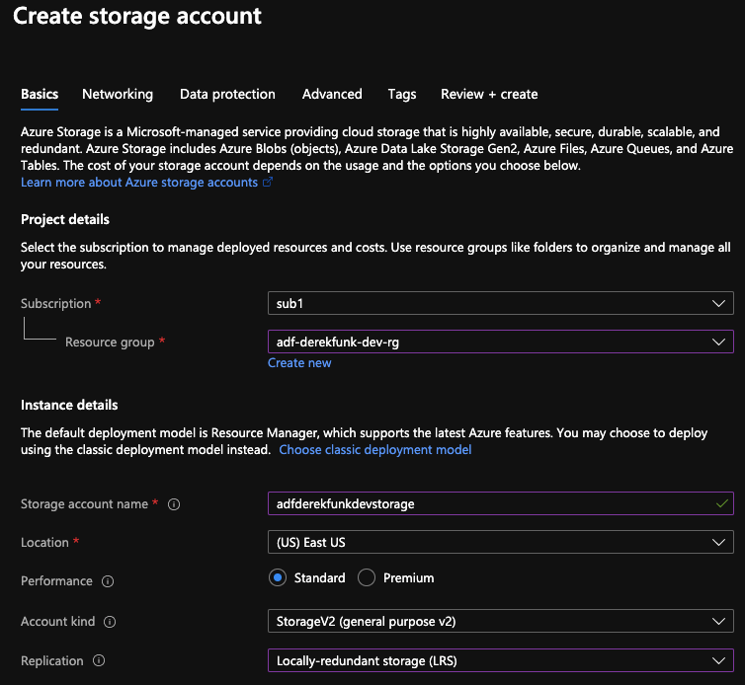
Step 1 - Task 5: Deploy an Azure Storage Account as below
Notes:
created new sa adfderekfunkdevstorage

Slide 10
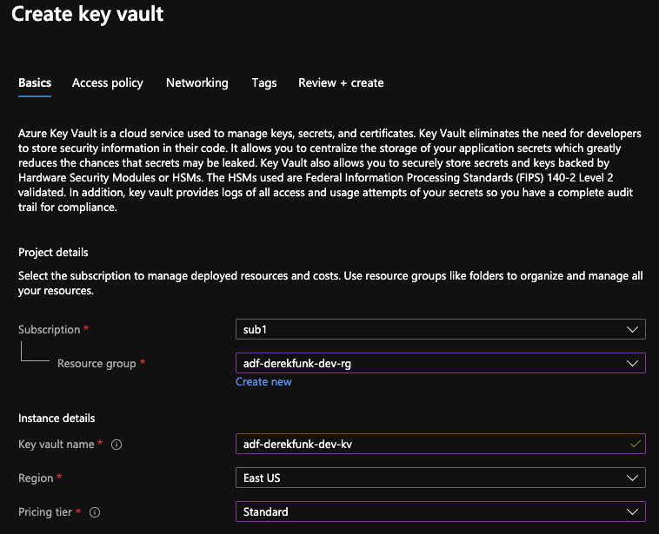
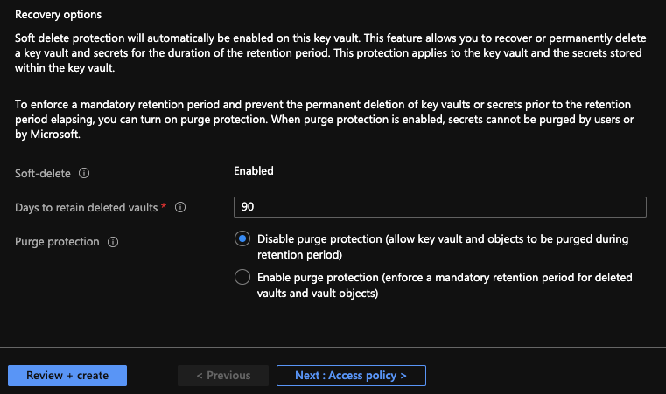
Step 1 - Task 6: Deploy Azure Key Vault
Notes:
created kv adf-derekfunk-dev-kv

Slide 11
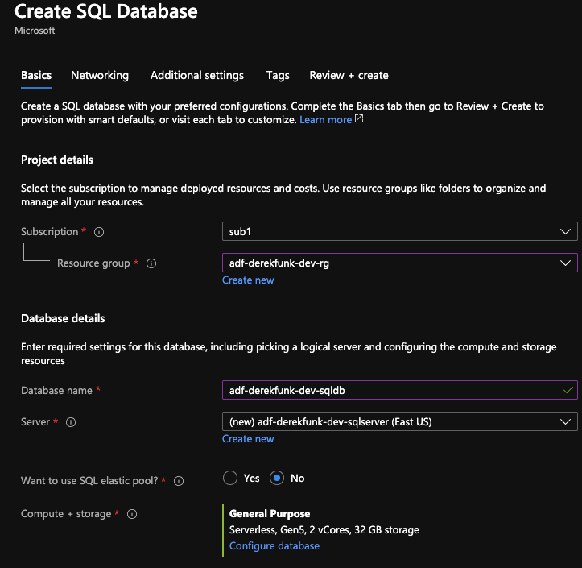
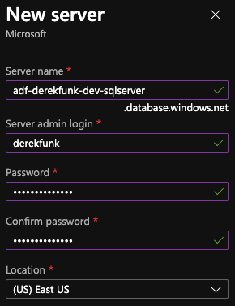
Step 1 - Task 7: Deploy Azure SQL Database (1/2)
Notes:
created sql server adf-derekfunk-dev-sqlserver
created SQL DB adf-derekfunk-dev-sqldb with this server

Slide 12
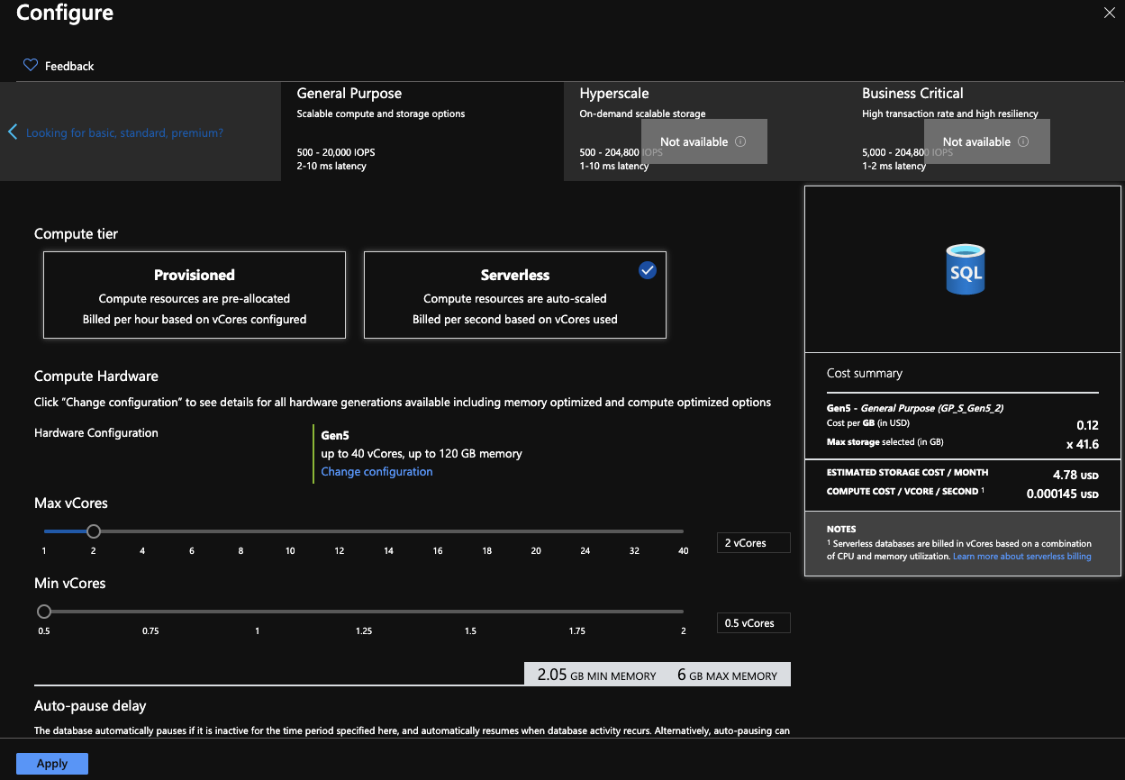
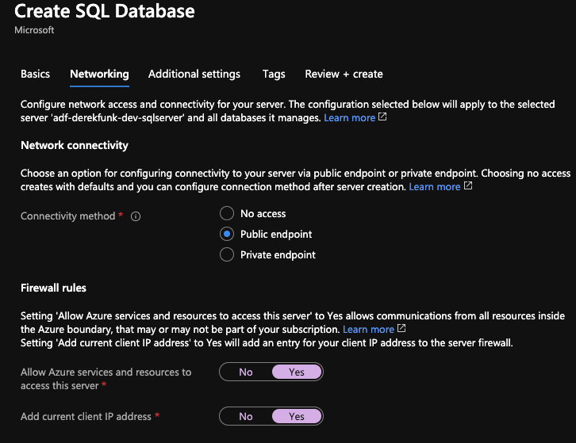
Step 1 - Task 7: Deploy Azure SQL Database (2/2)
Notes:
configured DB hardware (I could only do max 2 vCores) <- could be because of free account, continuing for now
made networking public

Slide 13
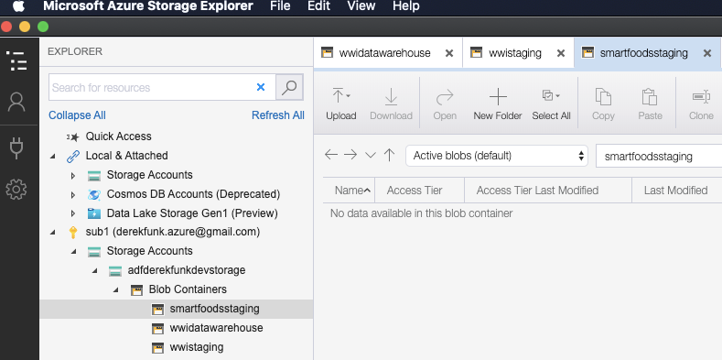
Step 1 - Tasks 8-10: Create Blob Storage Containers for the Data Warehouse Output and staging
Notes:
in SA adfderekfunkdevstorage, created 3 blob containers:
wwidatawarehouse
wwistaging
smartfoodsstaging

Slide 14
Step 2: Linked Services, Datasets and Integration Runtimes
https://github.com/Mmodarre/AzureDataFactoryHOL/tree/master/Lab-guide/02-Linked_Services_Datasets_and_Integration_Runtimes
Back to Table of Contents

Slide 15
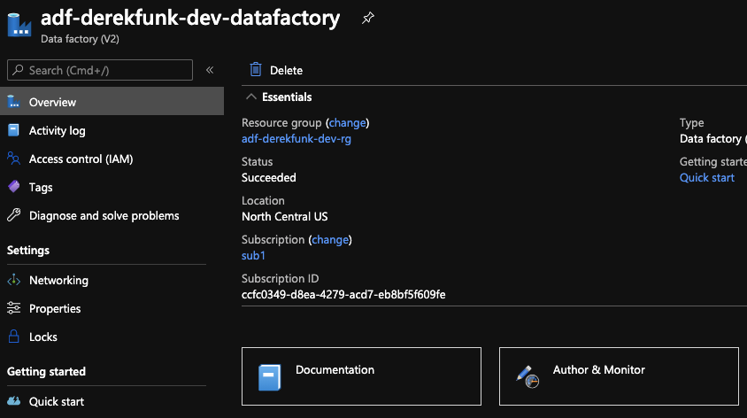
Step 2 - Task 1: Create Azure Data Factory Integration Runtime (1/3)
Notes:
author & monitor rg adf-derekfunk-dev-datafactory
opens new UI for ADF

Slide 16
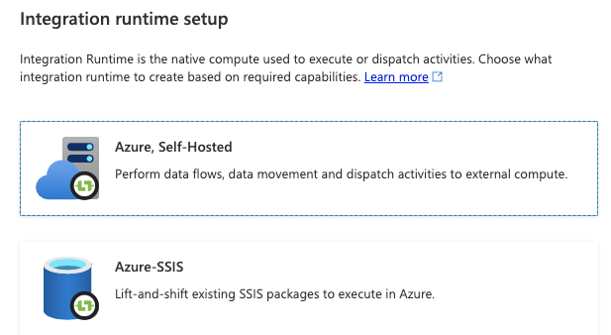
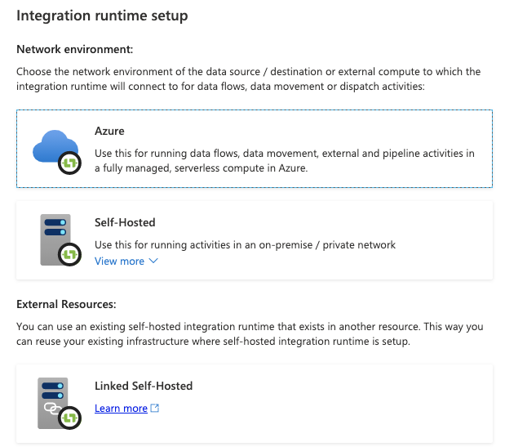
Step 2 - Task 1: Create Azure Data Factory Integration Runtime (2/3)
Notes:
Manage -> new IR

Slide 17
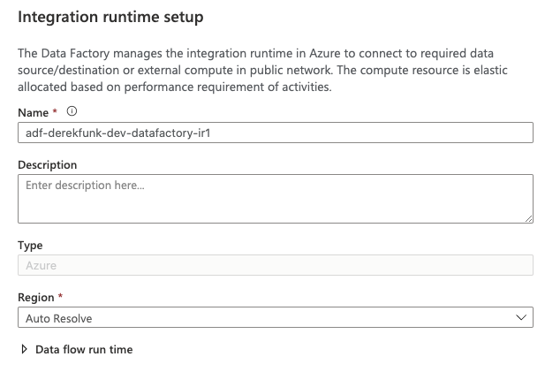
Step 2 - Task 1: Create Azure Data Factory Integration Runtime (3/3)
Notes:
named it adf-derekfunk-dev-datafactory-ir1

Slide 18
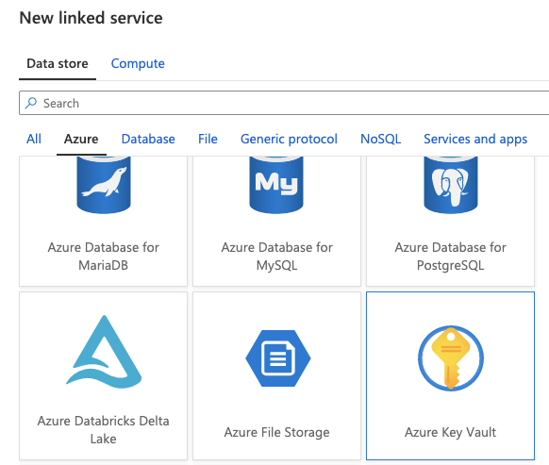
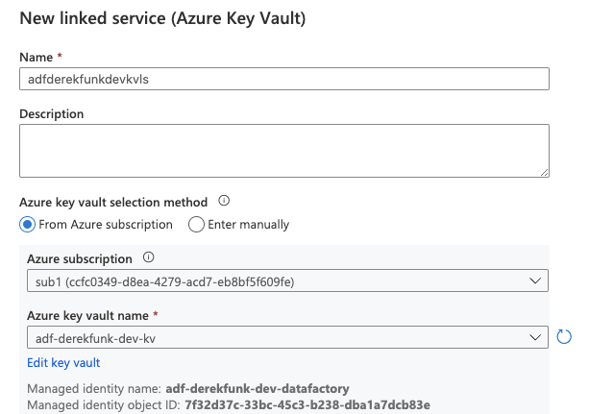
Step 2 - Task 2: Create a new ADF Key Vault Linked Service (1/3)
Notes:
Manage -> Connections -> Linked services -> Azure Key Vault
created linked service adfderekfunkdevkvls for existing kv adf-derekfunk-dev-kv
managed identity object ID: 7f32d37c-33bc-45c3-b238-dba1a7dcb83e
clicked on Edit key vault link

Slide 19
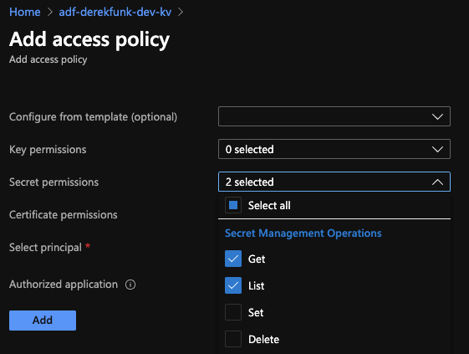
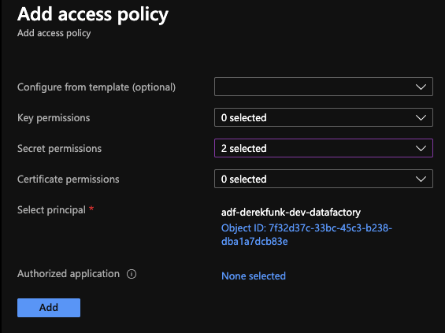
Step 2 - Task 2: Create a new ADF Key Vault Linked Service (2/3)
Notes:
Access Policies -> Add Access Poilcy
added Get and List secret permissions to this KV
added ADF adf-derekfunk-dev-datafactory to Select principal and saved

Slide 20
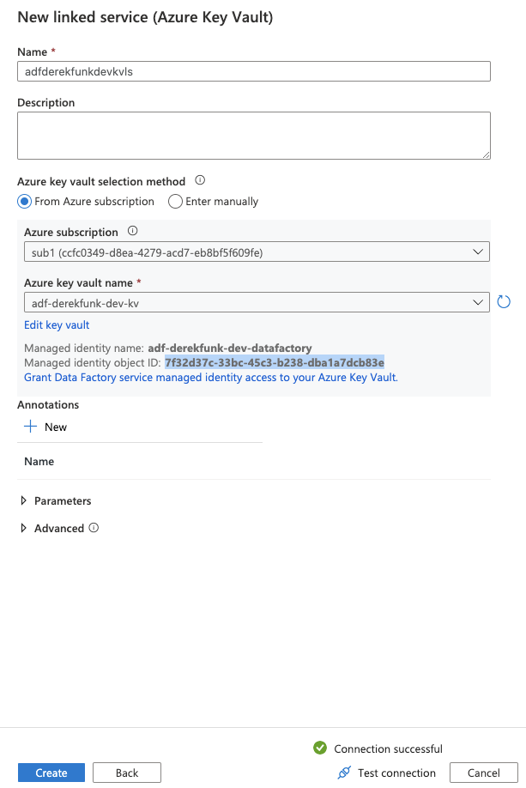
Step 2 - Task 2: Create a new ADF Key Vault Linked Service (3/3)
Notes:
tested connection of linked service and finished creation
made sure to click “Publish All”, otherwise linked service won’t actually save

Slide 21
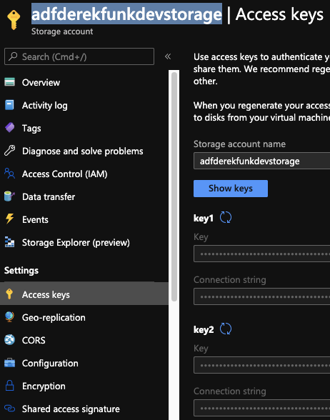
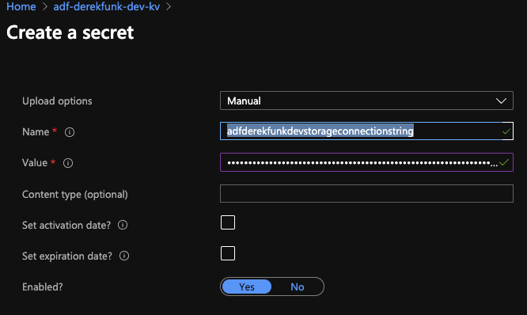
Step 2 - Task 3: Add blob Storage credentials to AKV
Notes:
obtained access key 1 connection string from SA adfderekfunkdevstorage
for KV adf-derekfunk-dev-kv, created a secret named adfderekfunkdevstorageconnectionstring with the value of the SA’s access key 1 connection string

Slide 22
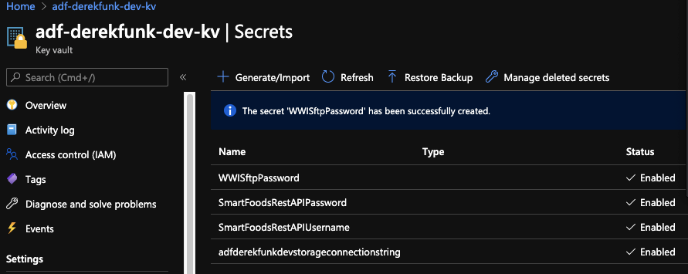
Step 2 - Task 4: Add other credentials to Azure Key Vault
Notes:
added the following 3 additional secrets to the KV adf-derekfunk-dev-kv:
SmartFoodsRestAPIUsername / adflab
SmartFoodsRestAPIPassword / Password.1!
WWISftpPassword / adflab

Slide 23
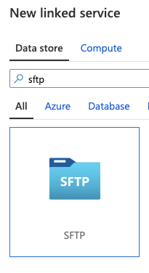
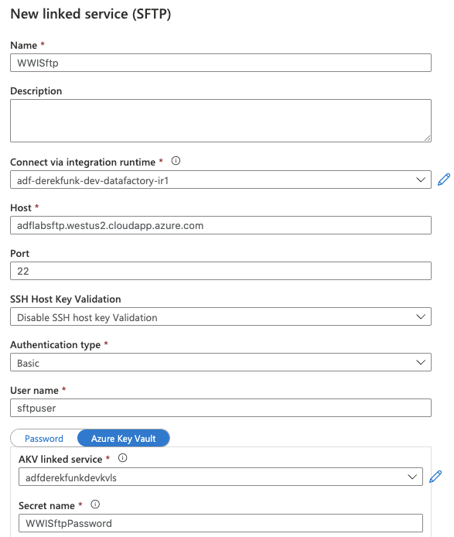
Step 2 - Task 5: Create SFTP Linked Service
Notes:
created SFTP LS WWISftp via IR adf-derekfunk-dev-datafactory-ir1
made sure to publish again

Slide 24
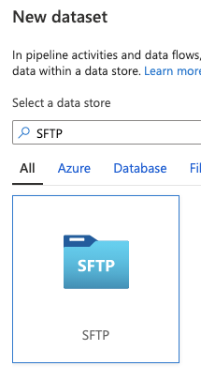
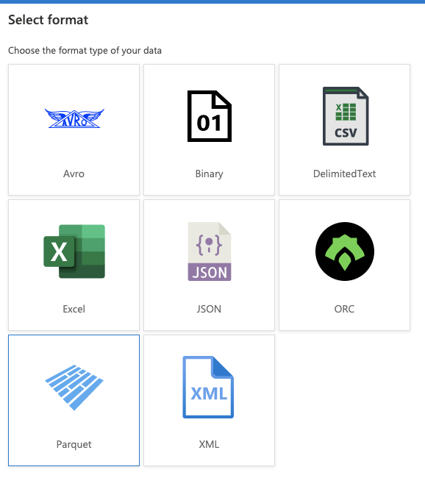
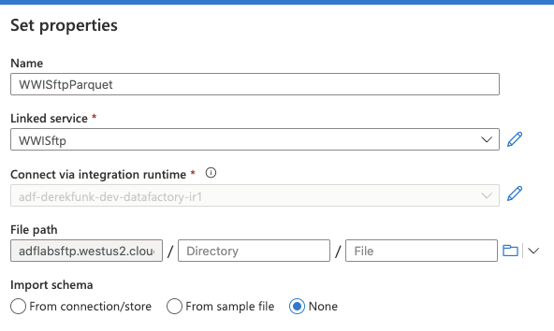
Step 2 - Task 6: Create datasets for WWI SFTP data (1/3)
Notes:
created a SFTP Parquet dataset WWISftpParquet with the LS WWISftp

Slide 25
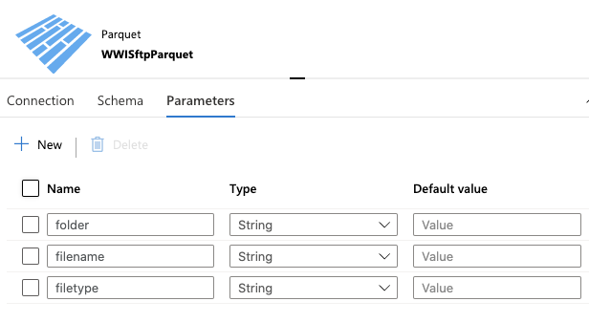
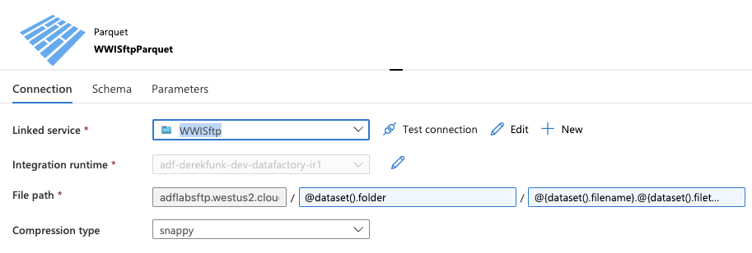
Step 2 - Task 6: Create datasets for WWI SFTP data (2/3)
Notes:
added 3 parameters to the dataset
referenced parameters in the connection
created and published

Slide 26
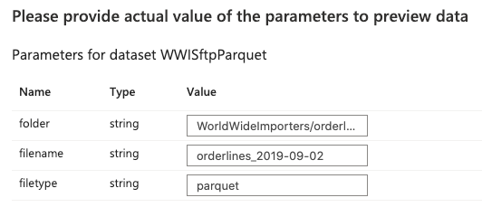
Step 2 - Task 6: Create datasets for WWI SFTP data (3/3)
Notes:
previewed dataset with actual values for the parameters <- didn’t work maybe because of free account, continuing for now

Slide 27
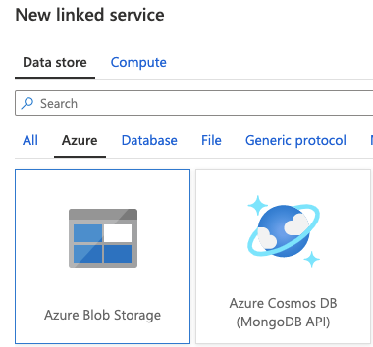
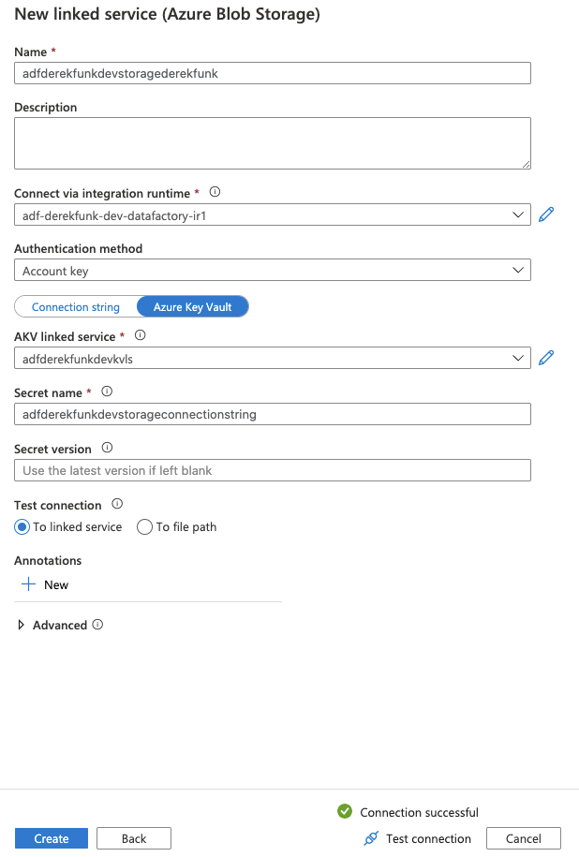
Step 2 - Task 7: Create Azure Blob Storage Linked Service
Notes:
created LS adfderekfunkdevstoragederekfunk for Blob Storage and published

Slide 28
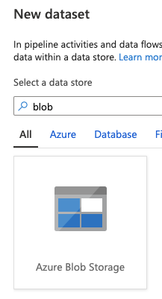
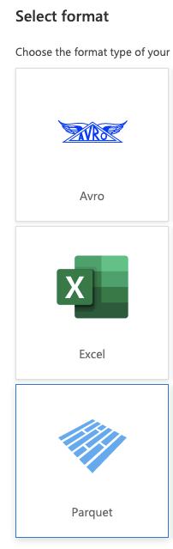
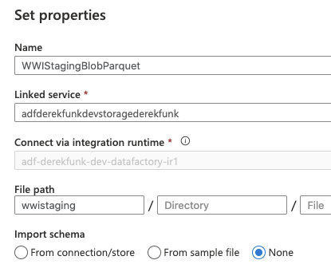
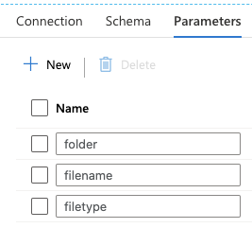
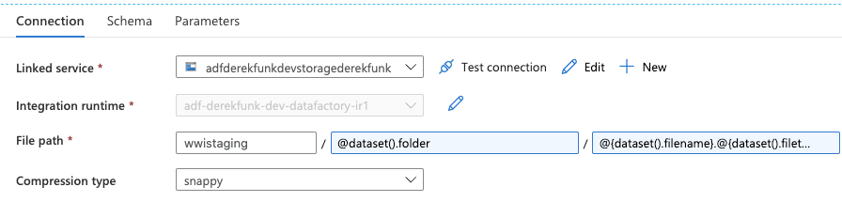
Step 2 - Task 8: Create Blob Storage Datasets for WWI Input data
Notes:
created dataset WWIStagingBlobParquet
gave it the same 3 parameters as the SFTP dataset

Slide 29
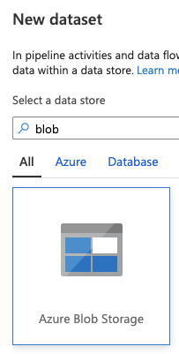
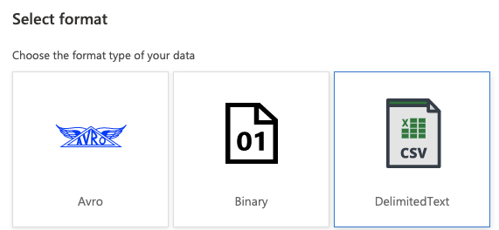
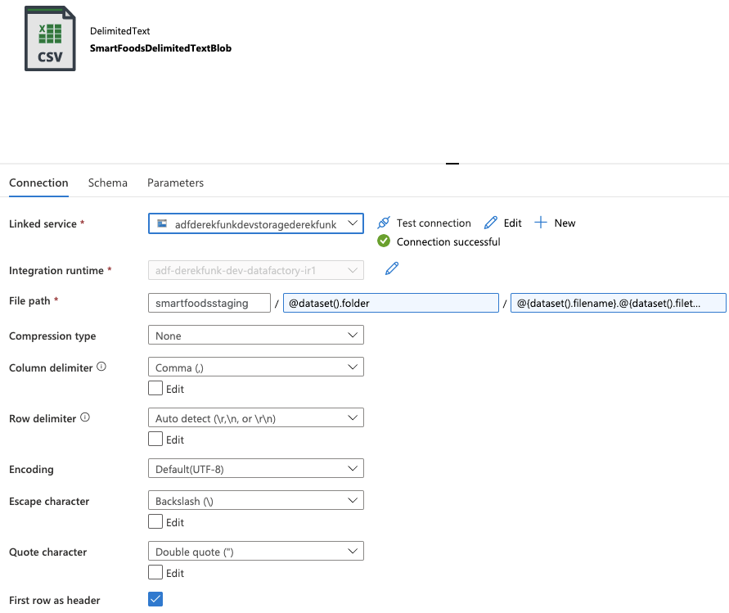
Step 2 - Task 9: Create Blob Storage Datasets for SmartFoods Input data
Notes:
created dataset SmartFoodsDelimitedTextBlob of type Azure Blob Storage with format DelimitedText
gave it the same 3 parameters as the SFTP dataset
lab is missing the check “First row as header”, which is required because the dates files will have “date” as the first value

Slide 30
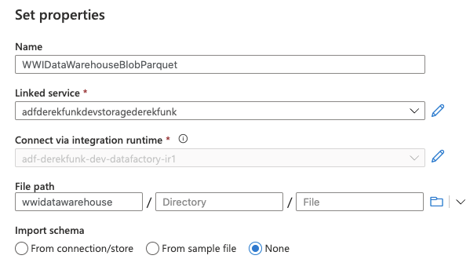
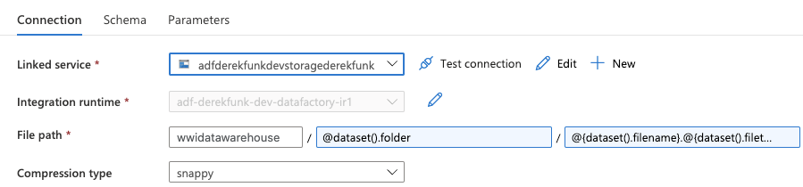
Step 2 - Task 10: Create Blob Storage Datasets for WWI Data Warehouse output
Notes:
created dataset WWIDataWarehouseBlobParquet with same 3 parameters

Slide 31
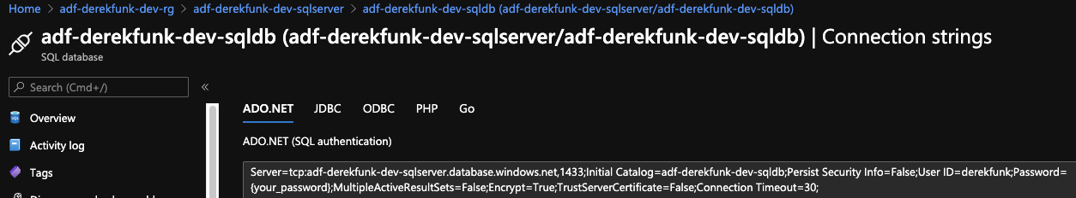
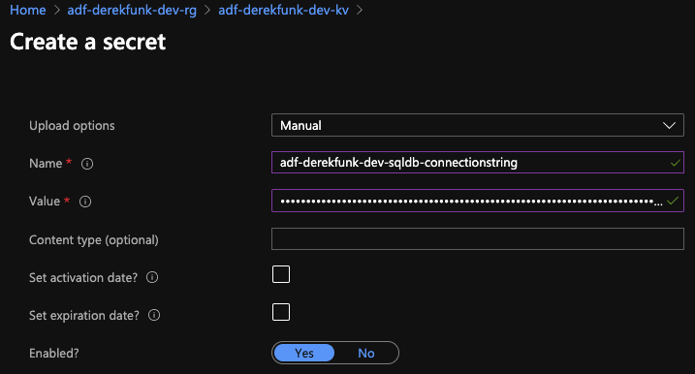
Step 2 - Task 11: Create a SQL Database Linked Service and Dataset (1/3)
Notes:
took connection string from DB adf-derekfunk-dev-sqldb (had to replace “password” with actual password in string)
made new KV secret adf-derekfunk-dev-sqldb-connectionstring with a value of this connection string

Slide 32
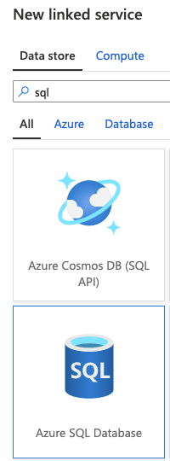
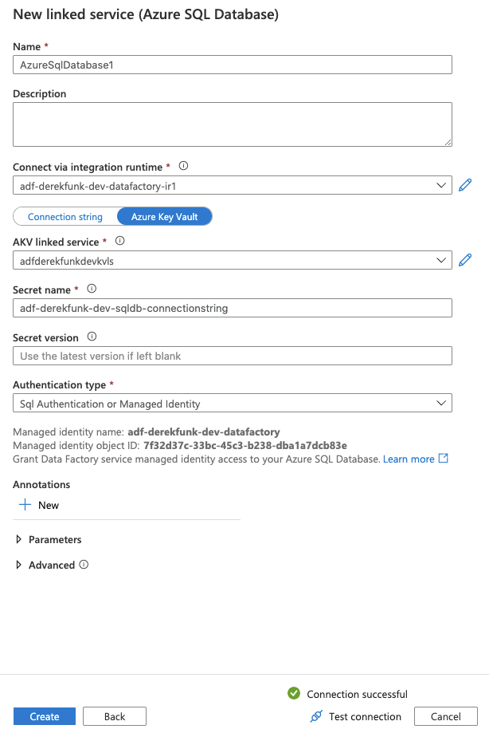
Step 2 - Task 10: Create a SQL Database Linked Service and Dataset (2/3)
Notes:
created LS AzureSqlDatabase1 that connects to SQL DB via this secret (could be named better but sticking with it since it gets referenced later)

Slide 33
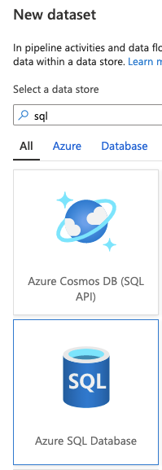



Step 2 - Task 10: Create a SQL Database Linked Service and Dataset (3/3)
Notes:
created dataset AzureSqlTable1 of type Azure SQL Database
gave it 2 parameters

Slide 34


Step 2 - Task 12: Create an HTTP Linked Service
Notes:
created LS SmartFoodsApiLinkedService of type HTTP

Slide 35




Step 2 - Task 13: Create a CSV Dataset on the HTTP Linked Service
Notes:
created dataset SmartFoodsTransactionApiCsv of type HTTP with format DelimitedText
created parameter authCode with relative URL = “smartfoods?code=@{dataset().authCode}”
lab did not include “First row as header” check, which you need since the smartfoods transaction files have headers

Slide 36





Step 2 - Task 14: Create a JSON Dataset on the HTTP Linked Service
Notes:
created dataset SmartFoodsCustomerApiJson of type HTTP with format JSON
created parameter authCode with relative URL = “smartfoods?code=@{dataset().authCode}”

Slide 37
Step 3: Copy Activity, Parameters, Debug and Publishing
https://github.com/Mmodarre/AzureDataFactoryHOL/tree/master/Lab-guide/03-Copy_Activity_Parameters_Debug_and_Publishing
Back to Table of Contents

Slide 38




Step 3 - Task 1: Create a pipeline and setup authentication to SmartFoods OAuth2 (Token based) API (1/3)
Notes:
created pipeline SmartFoodCustomerApiToBlob
created web activity AKVUsername with URL = “https://adf-derekfunk-dev-kv.vault.azure.net/secrets/SmartFoodsRestAPIUsername/e2bd74ffd8374e4c9061c9c1f7d65029?api-version=7.0” (username secret identifier + api version)

Slide 39


Step 3 - Task 1: Create a pipeline and setup authentication to SmartFoods OAuth2 (Token based) API (2/3)
Notes:
created another web activity AKVPassword with URL = “https://adf-derekfunk-dev-kv.vault.azure.net/secrets/SmartFoodsRestAPIPassword/8deca86d613c4b94908142e59e8648f1?api-version=7.0” (password secret identifier + api version)

Slide 40


Step 3 - Task 1: Create a pipeline and setup authentication to SmartFoods OAuth2 (Token based) API (3/3)
Notes:
created web activity SmartFoodsLogin that takes in username and password

Slide 41



Step 3 - Task 2: Store the access token in a variable
Notes:
created variable token
created set variable activity SetAccessToken with variable token = @activity('SmartFoodsLogin').output.token

Slide 42



Step 3 - Task 3: Retrieve data from API and store in Blob Storage
Notes:
created copy data activity SmartFoodsCustomersToBlob
source request body = @{json(concat('{"trans_date": "',pipeline().parameters.date,'","dataDomain" : "customers"}'))}
sink filename = smartfoods_customers_@{replace(pipeline().parameters.date,'-','')}

Slide 43



Step 3 - Task 4: Test your pipeline
Notes:
tested pipeline
checked file was written to blob storage
checked file itself and seems to match what’s in the lab

Slide 44
Step 4: Lookup activity, ForEach loop and Execute Pipeline activity
https://github.com/Mmodarre/AzureDataFactoryHOL/tree/master/Lab-guide/04-Lookup_activity__ForEach_loop_and_Execute_Pipeline_activity
Back to Table of Contents

Slide 45


Step 4 - Task 1: Extend the pipeline with Lookup activity and ForEach Loops (1/2)
Notes:
created parent pipeline InitialLoadSmartFoodCustomerApiToBlob
gave it a variable dates with an array of 4 dates (1st, 2nd, 3rd, and 4th of Jan 2020)

Slide 46



Step 4 - Task 1: Extend the pipeline with Lookup activity and ForEach Loops (2/2)
Notes:
added a foreach activity LoopSmartFoodsDates
in the activity, added an execute pipeline activity RunSmartFoodCustomerApiToBlob that calls the sub-pipeline SmartFoodCustomerApiToBlob

Slide 47

Step 4 - Task 2: Expand the pipeline using Lookup activity (1/3)
Notes:
took the github file AzureDataFactoryHOL/Data/SmartFoods/dates.csv (has the first 20 dates of 2020) and uploaded to a new folder ref_data in the smartfoodsstaging blob container

Slide 48


Step 4 - Task 2: Expand the pipeline using Lookup activity (2/3)
Notes:
created lookup activity LookupDates that pulls dates from csv
previewed csv lookup to verify it’s working

Slide 49


Step 4 - Task 2: Expand the pipeline using Lookup activity (3/3)
Notes:
set foreach activity’s items
changed sub-pipeline’s date value

Slide 50


Step 4 - Task 3: Test your pipeline
Notes:
test run produced 20 api call datasets (took about 5 minutes total)

Slide 51


Step 4 - Task 4: How much did this cost?
Notes:
you can click “View debug run consumption” to see resource cost (top image for outer pipeline, bottom image for 1 of the inner pipelines)

Slide 52




Step 4 - Task 5: Clone and modify SmartFoods customer pipeline for transactions (1/2)
Notes:
cloned the pipeline SmartFoodCustomerApiToBlob to a new pipeline SmartFoodTransactionApiToBlob to retain much of the same properties
this does the same as the customers pipeline, except pulls transactions for a specific date

Slide 53



Step 4 - Task 5: Clone and modify SmartFoods customer pipeline for transactions (2/2)
Notes:
tested this pipeline for 2020-02-10 and it worked, creating the csv into a new folder transactions in the blob container

Slide 54





Step 4 - Task 6: Add ‘Transaction’ pipeline to the ‘InitialLoad’ pipeline
Notes:
renamed parent pipeline to InitialLoadSmartFoodAllfeedsApiToBlob
in the foreach activity, added another execute pipeline activity that invokes the sub-pipeline SmartFoodTransactionApiToBlob
tested pipeline, it correctly output 20 transaction files
it also re-output the 20 customer files

Slide 55
Step 4 - Task 7: Publishing
Notes:
nothing done here, just a reminder that in this lab we are doing “Publish all” but in real life we should be using “Source Control” mode to fine tune versions of objects. Publish all saves everything that has been changed.

Slide 56
Step 5: Get Metadata activity, filter activity and complex expressions
https://github.com/Mmodarre/AzureDataFactoryHOL/tree/master/Lab-guide/05-Get_Metadata_activity_filter_activity_and_complex_expressions
Back to Table of Contents

Slide 57




Step 5 - Task 1: Load WWI Data (1/3)
Notes:
created pipeline WWICustomersSftpToBlob
gave it copy data activity CopyWWICustomerSFTPtoBlob
debugged with 2019-02-01 copies parquet file to blob container wwistaging
lab mistakenly refers to sink parameters as source again

Slide 58




Step 5 - Task 1: Load WWI Data (2/3)
Notes:
created pipeline WWIOrdersSftpToBlob
gave it copy data activity CopyWWIOrderSFTPtoBlob
debugged with 2019-02-06 copies parquet file to blob container wwistaging (2019-02-01 doesn’t exist for orders as lab suggests)
lab mistakenly refers to sink parameters as source again

Slide 59




Step 5 - Task 1: Load WWI Data (3/3)
Notes:
created pipeline WWIOrderlinesSftpToBlob
gave it copy data activity CopyWWIOrderlineSFTPtoBlob
debugged with 2019-02-06 copies parquet file to blob container wwistaging (2019-02-01 doesn’t exist for orderlines as lab suggests)
lab mistakenly refers to sink parameters as source again

Slide 60




Step 5 - Task 2: Setup Initial Load for WWI data (1/2)
Notes:
created pipeline InitialLoadWWICustomerSftpToBlob
metadata activity gets all filenames from the sftp folder WorldWideImporters/customers
filter activity filters out bad files (ones with “testing” or “old” in them)
items = @activity('GetWWICustomerFileListSFTP').output.childitems
condition = @not(or(contains(item().name,'testing'),contains(item().name,'old')))
foreach activity calls pipeline WWICustomersStftpToBlob for each of the good customer files
items = @activity('FilterWWISFTPCustomerFileNames').output.Value
date = @substring(item().name,add(indexof(item().name,'_'),1),10)

Slide 61


Step 5 - Task 2: Setup Initial Load for WWI data (2/2)
Notes:
debugging it copies all the customer parquet files to blob container

Slide 62





Step 5 - Task 3: Create Initial load pipelines for WWI ‘Orders’ and ‘Orderlines’ (1/2)
Notes:
cloned new pipeline InitialLoadWWIOrderSftpToBlob that will call the pipeline WWIOrdersSftpToBlob for each file in the folder WorldWideImporters/orders
left filter activities alone even though they might not be necessary for the orders (can’t hurt to have them)
debug pipeline copied over order parquet files

Slide 63





Step 5 - Task 3: Create Initial load pipelines for WWI ‘Orders’ and ‘Orderlines’ (2/2)
Notes:
cloned new pipeline InitialLoadWWIOrderlineSftpToBlob that will call the pipeline WWIOrderlinesSftpToBlob for each file in the folder WorldWideImporters/orderlines
left filter activities alone even though they might not be necessary for the orderlines (can’t hurt to have them)
debug pipeline copied over orderline parquet files

Slide 64
Step 6: Self-hosted Integration Runtime, decompress files and Delete activity
https://github.com/Mmodarre/AzureDataFactoryHOL/tree/master/Lab-guide/06-Self-hosted_Integration_Runtime__decompress_files_and_Delete_activity
Back to Table of Contents
Notes:
this step requires a Windows OS to perform
I used Windows 10 in VirtualBox on my mac
documentation: https://www.howtogeek.com/657464/how-to-install-a-windows-10-virtualbox-vm-on-macos/

Slide 65




Step 6 - Task 1: Create a self-hosted IR to access SmartFoods reference data from local file system
Notes:
created an IR OnPremisesIR
installed Integration Runtime on my virtual Windows

Slide 66


Step 6 - Task 2: Prepare the local machine
Notes:
on Windows, created a new user adf_ir
created a new folder adf_ir and pasted the folder SmartFoodsRefData.zip (from GitHub lab) here

Slide 67


Step 6 - Task 3: Create local file system Linked Service
Notes:
created linked service SmartFoodsLocalFileSystem of type File system
password is same as the one for the user adf_ir in Windows

Slide 68



Step 6 - Task 4: Create Dataset for file system
Notes:
created dataset SmartFoodsRefDataLocalFileSystem with data store File system and format DelimitedText

Slide 69



Step 6 - Task 5: (Challenge Task) Parametrize the dataset with
Notes:
gave this data set 2 parameters: file, filetype
reference parameters in connection’s file path
previewed data with file = SmartFoodsRefData, filetype = zip (previews shows a few rows from 1 of the 3 files inside the zip file)

Slide 70


Step 6 - Task 6: Copy the data from on-prem to cloud (1/3)
Notes:
cloned dataset SmartFoodsDelimitedTextBlob into SmartFoodsDelimitedTextBlobOnlyFolderPram
only difference is that filetype and filename are no longer parameters, just folder

Slide 71


Step 6 - Task 6: Copy the data from on-prem to cloud (2/3)
Notes:
created pipeline SmartFoodsRefDataLocalFStoBlob
begins with metadata activity GetSmartFoodsRefDataFileListLocalFS that pulls all the file names from the local zip file
foreach activity takes the file names from previous activity

Slide 72



Step 6 - Task 6: Copy the data from on-prem to cloud (3/3)
Notes:
in the foreach activity, created activity CopySmartFoodsRefDataLocalFStoBlob
source -> splits the current filename into just the name of the file and the extension zip
sink -> copies file into a ref_data folder in the blob container
pipeline debugs copies the zip file into the blob container smartfoodsstaging

Slide 73


Step 6 - Task 7: Delete the zip file from local file system
Notes:
added delete activity DeleteSmartFoodsRefDataLocalFS
This is supposed to remove the zip file on the local machine but it’s not working for me. I’m continuing as this doesn’t seem to be a big problem going forward.

Slide 74
Step 7.1: ELT with Mapping Dataflows
Step 7.2: Slowly changing dimension type 2 withMapping dataflow (customerDim)
https://github.com/Mmodarre/AzureDataFactoryHOL/tree/master/Lab-guide/07-SmartFoodsCustomerELT
Back to Table of Contents
Notes:
headsup: the lab has several errors that I’ve had to fix along the way, particularly around exact spelling of column names. I’ve stuck with Pascal casing, whereas the lab has sometimes deviated into camel or snake casing.

Slide 75
Step 7.1 - Task 1: Solution overview
Notes:
no task here, just description of the step
there are 3 systems we will be sending data to from ADF:
Azure SQL DB for Analytics Reporting teams
Azure Blob Storage for Data Science teams
Cosmos for SmartFoods app

Slide 76

Step 7.1 - Task 2: Create Data warehouse tables for SmartFoods in Azure SQLDB
Notes:
in DB adf-derekfunk-dev-sqldb, created a star schema
CREATE SCHEMA SmartFoodsDW;
GO
CREATE TABLE [SmartFoodsDW].[customerDim](
[CustomerKey] [bigint],
[LoyaltyNum] [nvarchar](max),
[FirstName] [nvarchar](max) NULL,
[LastName] [nvarchar](max) NULL,
[City] [nvarchar](max) NULL,
[State] [nvarchar](max) NULL,
[Email] [nvarchar](max) NULL,
[Address] [nvarchar](max) NULL,
[PostCode] [nvarchar](max) NULL,
[MemberSince] [date] NULL,
[Dob] [date] NULL,
[RecInsertDt] [date] NULL,
[RecStartDt] [date] NULL,
[RecEndDt] [date] NULL,
[RecCurrInd] [bit] NULL,
[sourceLineage] [nvarchar](max),
[RecMd5Hash] [nvarchar](max)
) ;
GO
CREATE TABLE [SmartFoodsDW].[foodDim](
[sku] [nvarchar](max),
[foodKey] [bigint],
[desc] [nvarchar](max) NULL,
[foodGroup] [nvarchar](max) NULL,
[RecInsertDt] [date] NULL,
[RecStartDt] [date] NULL,
[RecEndDt] [date] NULL,
[RecCurrInd] [bit] NULL,
[sourceLineage] [nvarchar](max),
[RecMd5Hash] [nvarchar](max)
) ;
GO
CREATE TABLE [SmartFoodsDW].[foodNutDim](
[foodKey] [bigint],
[nutrientId] [nvarchar](max),
[nutritionValue] [float] NULL,
[desc] [nvarchar](max) NULL,
[nutUnit] [nvarchar](60) NULL,
[RecInsertDt] [date] NULL
);
GO
CREATE TABLE [SmartFoodsDW].[invoiceLineTxn](
[invoiceNumber] [nvarchar](max),
[lineNumber] [int],
[foodKey] [bigint],
[itemDesc] [nvarchar](max) NULL,
[itemFoodGroup] [nvarchar](max) NULL,
[uPrice] [float],
[qty] [bigint],
[gst] [float],
[lineTotalGstExc] [float],
[lineTotalGstInc] [float],
[sourceLineage] [nvarchar](max),
[recInsertDt] [date]
);
GO
CREATE TABLE [SmartFoodsDW].[invoiceTxn](
[invoiceNumber] [nvarchar](max),
[loyaltyNum] [nvarchar](max) NULL,
[CustomerKey] [bigint] NULL,
[store] [nvarchar](max) NULL,
[State] [nvarchar](max) NULL,
[lineItemCount] [bigint],
[invoiceTotalGSTinc] [float],
[invoiceTotalGSTexc] [float],
[InvoiceGst] [float],
[timestamp] [datetime2](7),
[sourceFileLineage] [nvarchar](max),
[recInsertDt] [date]
) ;
GO

Slide 77
Step 7.1 - Task 3: Introduction to Mapping Data Flows
Notes:
no task here, just a description of Azure data flows

Slide 78



Step 7.2 - Task 1: Create a new Mapping Dataflow and add source dataset (1/2)
Notes:
created data flow SmartFoodsCustomerELT
turned on data flow debug
source dataset = SmartFoodsDelimitedTextBlob

Slide 79


Step 7.2 - Task 1: Create a new Mapping Dataflow and add source dataset (2/2)
Notes:
Projection -> Import projection
changed postCode type from short to string (Azure SQL DB doesn’t recognize short)
data preview shows what’s in the blob container file for debug parameters

Slide 80


Step 7.2 - Task 2: Add a parameter to Mapping Dataflow
Notes:
gave data flow 2 parameters
updated debug settings for these (lab didn’t mention this)

Slide 81

Step 7.2 - Task 3: Break the Name field to firstName and lastName fields
Notes:
added transformation AddFirstNameLastName that splits the name field into 2 new fields first and last name

Slide 82

Step 7.2 - Task 4: How to save (Publish) your Dataflow?
Notes:
ADF data flow can’t be published & saved without a sink
this task is just putting a temporary sink that we will remove later so we can checkpoint now

Slide 83


Step 7.2 - Task 5: Remove extra columns and Rename columns using “Select” transformation
Notes:
new transform select FixColumnNamesRemoveName
removed name column
aliased all columns with “i” in frontFixColumnNamesRemoveName
debug shows expected output

Slide 84


Step 7.2 - Task 6: Calculate MD5 Hash of all non-key columns
Notes:
new derived column transform MD5Hash that will change if any of the dimensions change with new data (for Slowly Changing Dimensions)
adds a column with the expression:
md5( iif(isNull(iEmail),'',toString(iEmail))+
iif(isNull(iDob),'',toString(iDob))+
iif(isNull(iAddress),'',toString(iAddress))+
iif(isNull(iCity),'',toString(iCity))+
iif(isNull(iState),'',toString(iState))+
iif(isNull(iPostCode),'',toString(iPostCode))+
iif(isNull(iMembersince),'',toString(iMembersince))+
iif(isNull(iFirstName),'',toString(iFirstName))+
iif(isNull(iLastName),'',toString(iLastName)))
derived column shows in data preview

Slide 85



Step 7.2 - Task 7: Add DW table source (1/2)
Notes:
new source SmartFoodsCustomerSQLDW that pulls from dataset AzureSqlTable1
added a couple debug parameters
imported projection of sql table

Slide 86

Step 7.2 - Task 7: Add DW table source (2/2)
Notes:
added filter transform CurrentRecordsOnly

Slide 87

Step 7.2 - Task 8: Compare staging records with DW records to identify updates and inserts
Notes:
added join transform after md5 transform JoinStagingToDWDim

Slide 88

Step 7.2 - Task 9: Identify Updates/Inserts using “Conditional Split” transformation
Notes:
after join, added conditional split transform SDC2Split

Slide 89

Step 7.2 - Task 10: Handling New records (New stream)
Notes:
after new dataset, added select transform SelectNewInsert
kept just the first 12 columns and re-aliased them back without the “i”s

Slide 90

Step 7.2 - Task 11.1: Handling Changed records (Changed stream)
Notes:
branched the conditional split Changed

Slide 91


Step 7.2 - Task 11.2: Updating existing changed records (Closing old records)
Notes:
after the 1st Changed added select transform SelectChangedUpdate that retains just 15 of the columns
after that added derived column transform UpdateRecsBatchColumns to put back 2 of the columns

Slide 92

Step 7.2 - Task 11.3: Adding new version of the changed records
Notes:
after the 2nd Changed added select transform SelectChangedInsert that retains just the 12 “i” columns

Slide 93


Step 7.2 - Task 12: Putting together all inserts “New” and “Changed” together
Notes:
at the top New split, added a union transform ALLInserts that combines the new split with the Changed2 split
data preview seems to be working

Slide 94

Step 7.2 - Task 13: Generate Surrogate Keys
Notes:
added surrogate key SurrogateKey

Slide 95

Step 7.2 - Task 14: Fix surrogate key value
Notes:
added derived column AddMaxCustomerKey

Slide 96

Step 7.2 - Task 15: Add Batch columns to our “Insert” dataset
Notes:
added another derived column InsertRecsBatchColumns

Slide 97

Step 7.2 - Task 16: Put Insert and Update records together
Notes:
added union UnionInsertUpdates
lab says 16 but I think I am getting correct 17 columns at this point

Slide 98

Step 7.2 - Task 17: Prepare the dataset for sink (Alter row transformation)
Notes:
added an alter row MarkRow

Slide 99


Step 7.2 - Task 18: Writing to destination DW table
Notes:
added sink DBSink
deleted the old temporary sink

Slide 100


Step 7.2 - Task 19: Preview the final dataset (Debug)
Notes:
set debug parameters to above
preview pretty much matches the lab

Slide 101


Step 7.2 - Task 20: Inspect the Dataflow “Script”
Notes:
there is an option to the top right to view the entire data flow as a script

Slide 102


Step 7.2 - Task 21: Building the pipeline for the dataflow
Notes:
created new pipeline SmartFoodsCustomerELTBlobToSql that calls our ELT data flow

Slide 103




Step 7.2 - Task 22: Debug the pipeline manually
Notes:
added a few manual parameters for a debug
pipeline works and outputs rows to SQL DB

Slide 104






Step 7.2 - Task 23: Enhance the pipeline
Notes:
added lookup MaxCustomerKey
updated data flow parameters to be expressions
now when you debug you can enter a date string

Slide 105


Step 7.2 - Task 24: (Challenge Task) Create an initial load pipeline for this DF
Notes:
created pipeline SmartFoodsInitialLoadELT
loops over an array of dates to load the first days by calling SmartFoodsCustomerELTBlobToSql repeatedly

Slide 106
Step 8: ELT with Mapping Dataflows
https://github.com/Mmodarre/AzureDataFactoryHOL/tree/master/Lab-guide/08-ELT_with_Mapping_Dataflows%E2%80%93Practice_excercises
Back to Table of Contents

Slide 107
Step 8 - Task 1: Create Data warehouse tables for SmartFoods in Azure SQLDB
Notes:
already did this in previous step

Slide 108

Step 8 - Task 2: Practice exercise – Create Dataflow ELT for FoodDim (1/13)
Notes:
new data flow SmartFoodFoodELT

Slide 109


Step 8 - Task 2: Practice exercise – Create Dataflow ELT for FoodDim (2/13)
Notes:
new data flow SmartFoodFoodELT

Slide 110


Step 8 - Task 2: Practice exercise – Create Dataflow ELT for FoodDim (3/13)
Notes:
added debug settings

Slide 111

Step 8 - Task 2: Practice exercise – Create Dataflow ELT for FoodDim (4/13)
Notes:
imported projection

Slide 112



Step 8 - Task 2: Practice exercise – Create Dataflow ELT for FoodDim (5/13)
Notes:
added select and derived column transforms
added new source

Slide 113



Step 8 - Task 2: Practice exercise – Create Dataflow ELT for FoodDim (6/13)
Notes:
updated debug settings
imported projection for new data source
added conditional split (lab calls it a filter because this conditional split is being used as a filter)

Slide 114


Step 8 - Task 2: Practice exercise – Create Dataflow ELT for FoodDim (7/13)
Notes:
added join
added another conditional split

Slide 115


Step 8 - Task 2: Practice exercise – Create Dataflow ELT for FoodDim (8/13)
Notes:
branched the Changed stream
in the 1st branch, added select and derived column transforms

Slide 116

Step 8 - Task 2: Practice exercise – Create Dataflow ELT for FoodDim (9/13)
Notes:
on the 2nd branch, added a select transform

Slide 117


Step 8 - Task 2: Practice exercise – Create Dataflow ELT for FoodDim (10/13)
Notes:
back at the top split, added select transform
added union transform

Slide 118


Step 8 - Task 2: Practice exercise – Create Dataflow ELT for FoodDim (11/13)
Notes:
added surrogate key
added derived column

Slide 119


Step 8 - Task 2: Practice exercise – Create Dataflow ELT for FoodDim (12/13)
Notes:
added derived column
added union

Slide 120



Step 8 - Task 2: Practice exercise – Create Dataflow ELT for FoodDim (13/13)
Notes:
added alter row
added sink

Slide 121


Step 8 - Task 3: Create Dataflow ELT for foodNutrientsDim (1/8)
Notes:
new dataflow
new source

Slide 122


Step 8 - Task 3: Create Dataflow ELT for foodNutrientsDim (2/8)
Notes:
2 additional sources

Slide 123


Step 8 - Task 3: Create Dataflow ELT for foodNutrientsDim (3/8)
Notes:
updated debug settings

Slide 124



Step 8 - Task 3: Create Dataflow ELT for foodNutrientsDim (4/8)
Notes:
imported projections from all 3 sources
for 3rd source, lab did not have sourceLineage. not sure why but continuing

Slide 125



Step 8 - Task 3: Create Dataflow ELT for foodNutrientsDim (5/8)
Notes:
added 2 filters and a select

Slide 126


Step 8 - Task 3: Create Dataflow ELT for foodNutrientsDim (6/8)
Notes:
added 2 joins

Slide 127


Step 8 - Task 3: Create Dataflow ELT for foodNutrientsDim (7/8)
Notes:
added select and derived column transforms

Slide 128


Step 8 - Task 3: Create Dataflow ELT for foodNutrientsDim (8/8)
Notes:
added sink

